Slide 1
Implications of Cybersecurity Data Sharing
Jacob Blazina
blazinaj@cwu.edu

Slide 2
Introduction
Sharing cybersecurity data has pros and cons
Data is shared for Anti-Virus, Intrusion Detection, and Incident Investigation
Recent executive order mandates more sharing between private organizations and government
Leaked cybersecurity data is doubly sensitive
Notes:
Presenters background
3 years of Cybersecurity experience
Pen Tests, Phishing Tests, Risk Assessments, Audits, Incident Response, BC planning
Software development for the above things

Slide 3
Cybersecurity Information Sharing
Companies that provide anti-malware services utilize threat information sharing to rapidly respond to a growing list of cyber vulnerabilities
Upwards of 83% of the damage done happens within the first minutes or hours of an incident, while around 89% of the discovery doesn’t happen until days or weeks later (Haas)
Intrusion Detection Systems (IDS) that can pick up on anomalous data by pattern matching with previously shared incident data from other organizations
Notes:
- Modern examples include FinTechs and the need to share cybersecurity information with parent FIs

Slide 4
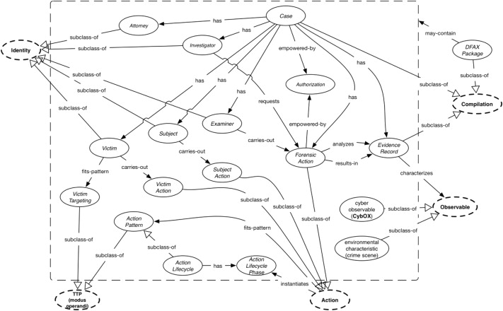
Technical Solutions to Cybersecurity Sharing
Frameworks
Languages
APIs
Software Platforms
Notes:
Frameworks – DFAX and CASE
Languages – CybOX
Platforms – Rivial Data Security

Slide 5

Shortcomings of closed-door Incident Response Investigations
Slower detection and response results in more damage
83% of damage done in the first hours
Takes weeks to discover the full extent of the incident
Hard to pinpoint attack vectors due to internal bias

Slide 6
Quantifying the Risks cybersecurity data sharing
Hard to determine incident scales
Difficult to apply previous incident data to predicted incidents
Technical approaches require heavily engineered systems up front – barrier to entry to most organizations
Cybersecurity data is doubly risky – can lead to even more loss of data
Notes:
involves engineering systems in a very precise way to accurately calculate how much data was leaked in an incident.
authors even address that their approach is difficult to scale and is computationally expensive

Slide 7
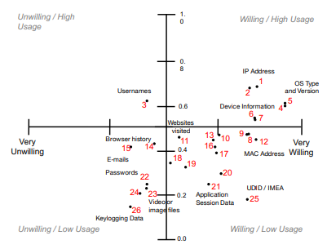
Privacy Concerns
People don’t want their data shared with outside sources
Incident data is inherently full of private information that must be analyzed by investigators
Notes:
Data that gets reviewed in incident investitations includes:
Browser history
Login history
Emails
Messages
Files

Slide 8
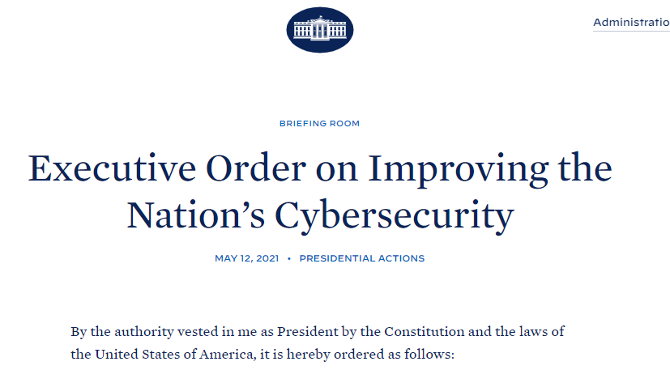
Current Events
Organizations must share incident data with government on request
More transparency on information system security
Faster turn around for incident data response

Slide 9
Conclusion
Cybersecurity landscape continues to evolve
Increasing government involvement in private security
Balance between Technical Risk and Privacy Risk
Notes:
Sharing cybersecurity information can be beneficial to the overall security landscape
Sharing cybersecurity information creates new attack vectors
Cybersecurity information is inherently private and sensitive
Government involvement has it’s pros and cons

Slide 10
References
Andreas, P., Bortolameotti, R., Everts, M., Jonker, W., & Hartel, P. Reliably determining data leakage in the presence of strong attackers. ACSAC ’16: Proceedings of the 32nd Annual Conference on Computer Security Applications
Bhatia, J., Breaux, T., Friedberg, L., Hibshi, H., & Smullen, D. Privacy risk in cybersecurity data sharing. WISCS ’16: Proceedings of the 2016 ACM on Workshop on Information Sharing and Collaborative Security
Bennet, D. (2021). The challenges facing computer forensics investigators in obtaining information from mobile devices for use in criminal investigations. Information Security Journal: A Global Perspective, 21(3)
Biden, J. (2021). Executive order on improving the nation’s cyber-security. https://www.whitehouse.gov/briefing-room/presidential-actions/2021/05/12/executive-order-on-improving-the-nations-cybersecurity/
Casey, E., Back, G., & Barnum, S. (2015). Leveraging cybox to standardize representation and exchange of digital forensic information. Digital Investigation: The International Journal of Digital Forensics Incident Response, 21(S1)
Casey, E., Barnum, S., Griffith, R., Snyder, J., Beek, H., & Neson, A. (2017). Advancing coordinated cyber-investigations and tool interoperability using a community developed specification language. Digital Investigation: The International Journal of Digital Forensics Incident Response, 22("C")
Haass, J., Ahn, G., & Grimmelmann, F. (2015). Actra: A case study for threat information sharing. WISCS ’15: Proceedings of the 2nd ACM Workshop on Information Sharing and Collaborative Security, 21
Meyer, P., Hiesgen, R., Schmidt, T., Nawrocki, M., & Wahlisch, M. Towards distributed threat intelligence in real-time. SIGCOMM Posters and Demos ’17: Proceedings of the SIGCOMM Posters and Demos
Spring, J. & Illari, P. Review of human decision-making during computer security incident analysis. Digital Threats: Research and Practice
Zou, Y. & Schaub, F. Concern but no action: Consumers’ reactions to the equifax data breach. CHI EA ’18: Extended Abstracts of the 2018 CHI Conference on Human Factors in Computing Systems

